Slide 1


Slide 2

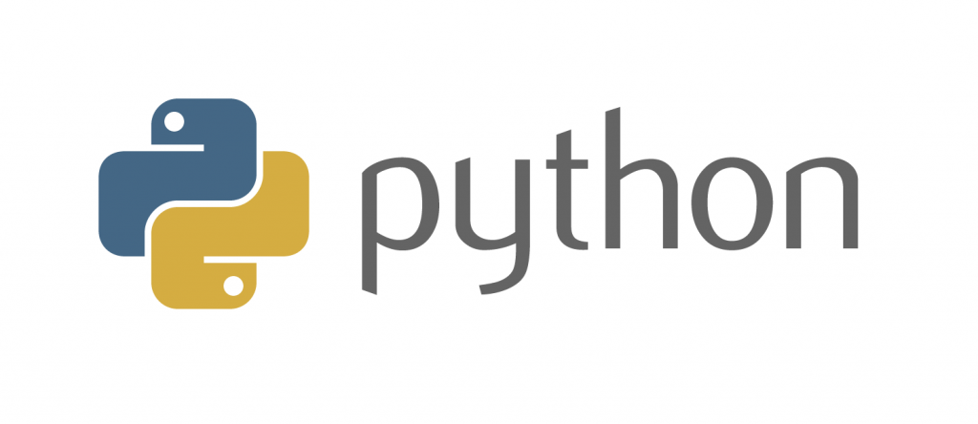
Introduction to
Part 1
Notes:
- Welcome and thank you for coming
- Introduction
- aims:
-- introduce fundamentals
-- build up confidence for self-study!!! Not as scary as the real-world version
- assumptions:
-- basic high-school maths
-- no prior experience in coding
CC-BY Digital Skills Team at the University of Edinburgh www.ed.ac.uk/is/skills

Slide 3

Ask!
The art and science of asking questions is the source of all knowledge.
- Thomas Berger
Do not hesitate to ask!
If something is not clear, stop me and ask.
During exercises (you can also ask others).
Image by mohamed Hassan from Pixabay
Notes:
All of us learn through asking and being curious
more of a conversation - don't hesitate to stop me and ask

Slide 4
Now let me ask something..
Why do you want to learn Python/programming?
What would you use Python for?
Notes:
make notes

Slide 5
Failure
Coding is all about trial and error.
Don't be afraid of it.
Error messages aren't scary, they are useful.
Notes:
You might fail 5 times while doing something but in the end you will understand how it works and be able to replicate it

Slide 6
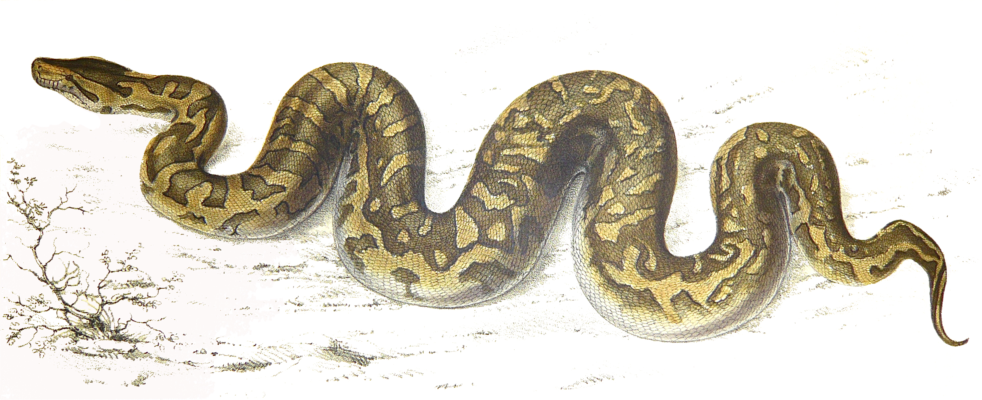
Python natalensis by A. Smith on Wikimedia Commons

Slide 7
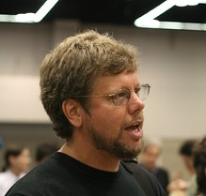
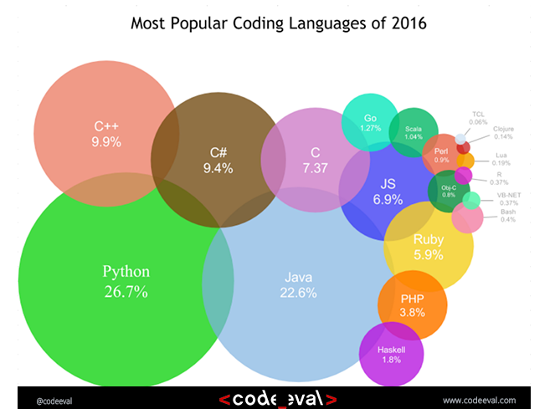
History
Started by Guido Van Rossum as a hobby
Now widely spread
Open Source! Free!
Versatile
Guido Van Rossum by Doc Searls on Flickr CC-BY-SA
Notes:
- Started by Guido Van Rossum as a hobby over the Christmas vacation.
- named after Monty Python's Flying Circus
- First released in 1991, loved by Unix scripters
- Now transformed into the most popular interpreted language. You can build anything with it!
- Facts! Python was the most used language in 2016 and still most likely is!

Slide 8
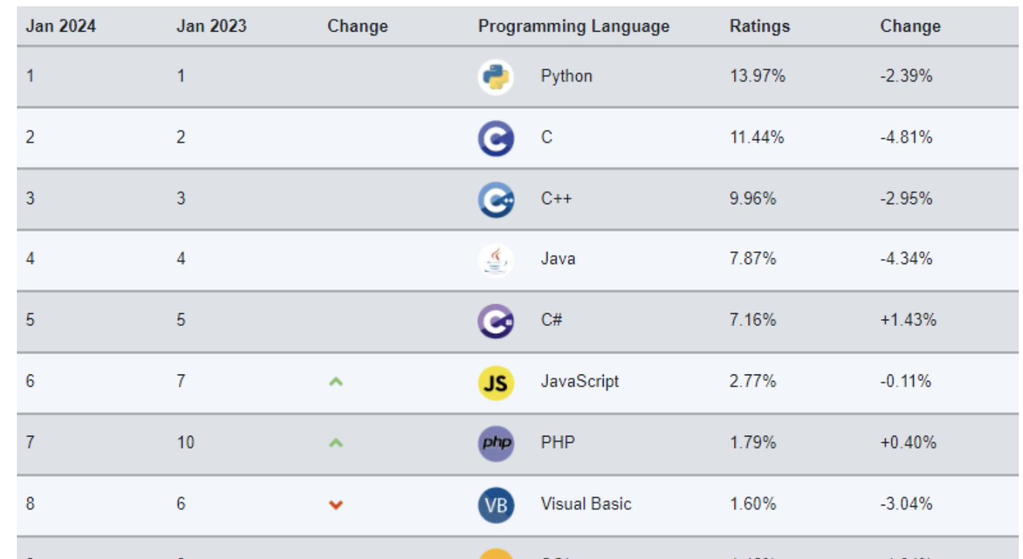
History
Started by Guido Van Rossum as a hobby
Now widely spread
Open Source! Free!
Versatile
Guido Van Rossum by Doc Searls on Flickr CC-BY-SA
Notes:
- Started by Guido Van Rossum as a hobby over the Christmas vacation.
- named after Monty Python's Flying Circus
- First released in 1991, loved by Unix scripters
- Now transformed into the most popular interpreted language. You can build anything with it!
- Facts! Python was the most used language in 2016 and still most likely is!

Slide 9
Python today
Developed a large and active scientific computing and data analysis community
Now one of the most important languages for
Data science
Machine learning
General software development
Packages: NumPy, pandas, matplotlib, SciPy, scikit-learn, statsmodels
Notes:
Why choose it instead of MATLAB, R, SAS, Stata and others?
- It is free and open source
- Intuitive and easy to learn
- Extremely versatile – examples – websites, planes, robots, data
- Large and friendly community
- packages
Very important in industry and academia

Slide 10
2 Modes
IPython
Python can be run interactively
Used extensively in research
2. Python scripts
What if we want to run more than a few lines of code?
Then we must write text files in .py
Notes:
Python has 2 modes of running
- IPython stands for Interactive Python
Python can be interpreted – good for a calculator
Live demo!

Slide 11
Time for a demo..
https://www.bilibili.com/video/BV1uW411q72j/?spm_id_from=333.337.search-card.all.click&vd_source=e7a59e905cb6cbd132428cf3d297b6c7
Notes:
- showcase power of Python
- you're not expected to understand all of it

Slide 12
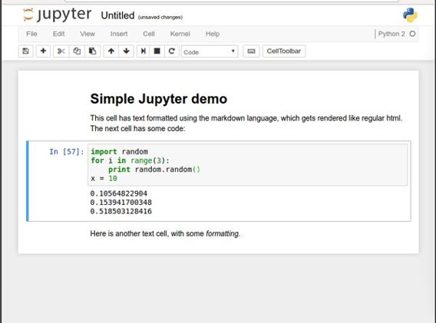
Noteable (Jupyter notebooks)
Easy to use environment
Web-based
Combines both text and code into one
Come with a great number of useful packages
Notes:
We will be using Noteable, just another service Jupyter Notebooks. It is free and open source
Web environment focused at Python
Easy to use – nice gui and no setup required
Block based. Has blocks which execute the code within it. Single type only
Allows to combine text and code into same page. Helps with readability

Slide 13
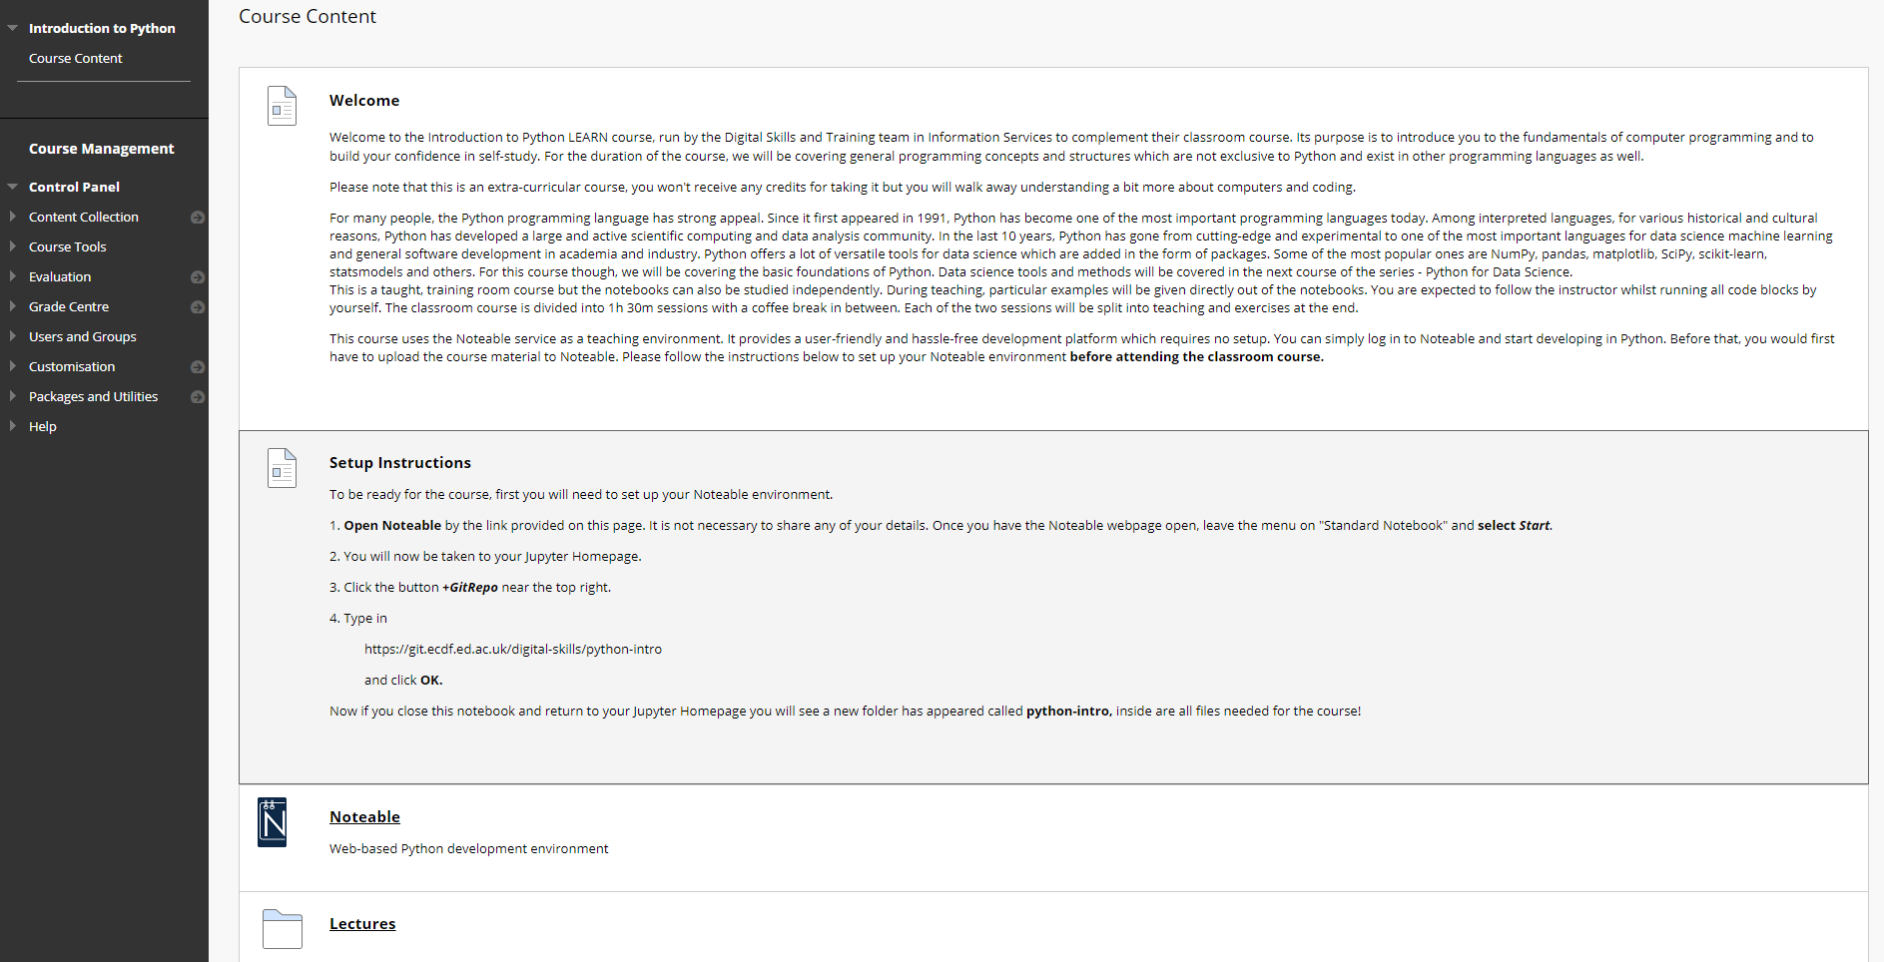
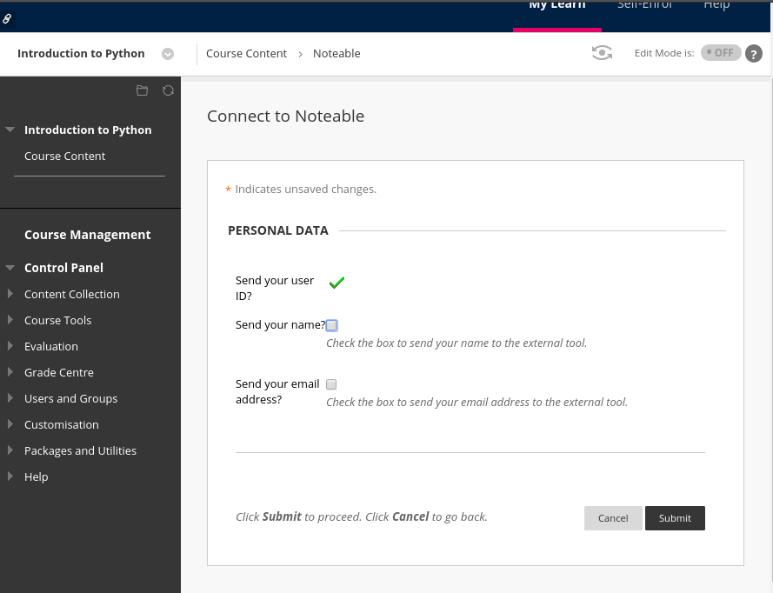
1. Start Noteable
Notes:
start noteable from learn - Link at the top of homepage
Agree on personal data usage
You don't have to share anything

Slide 14
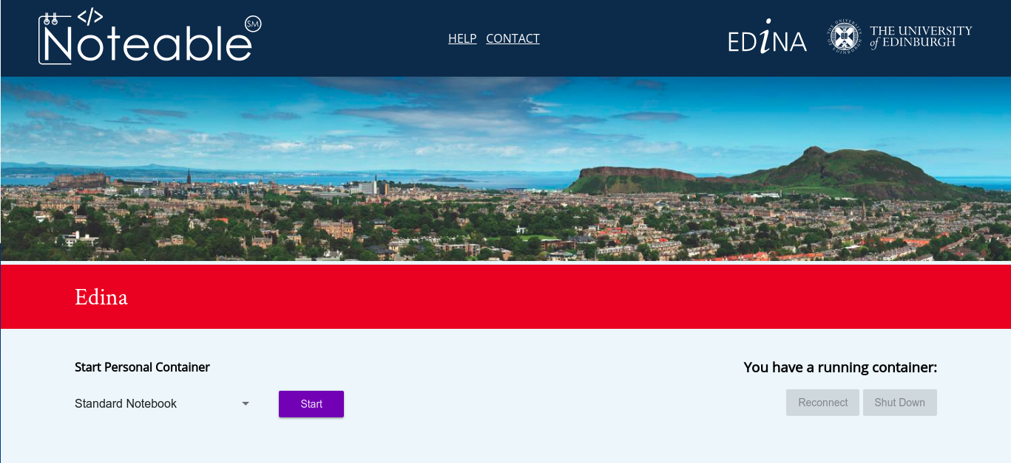
Notes:
Probably enter myed login details
Then press start on noteable homepage

Slide 15
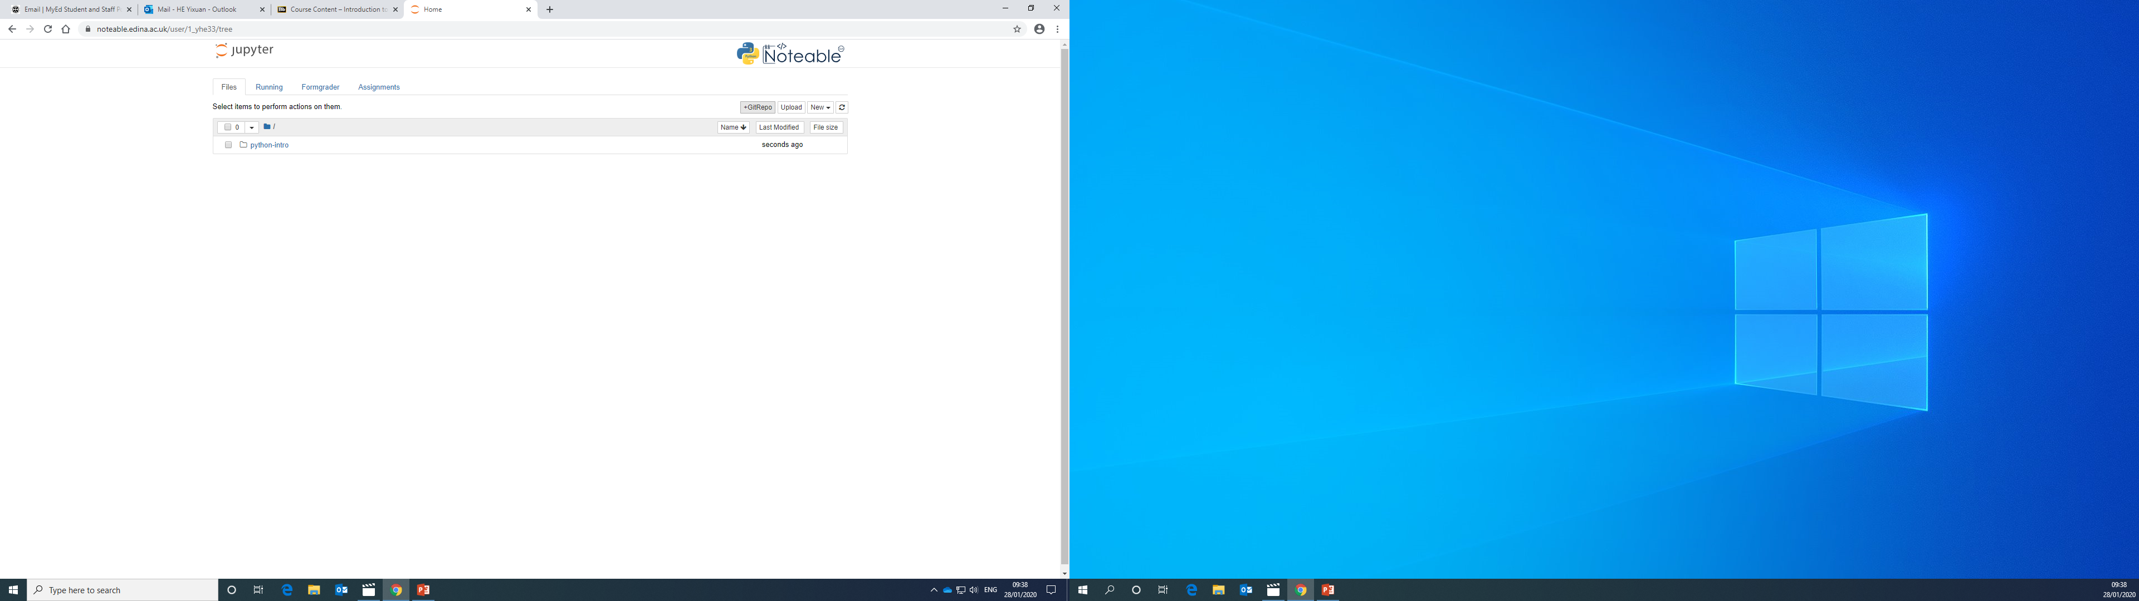
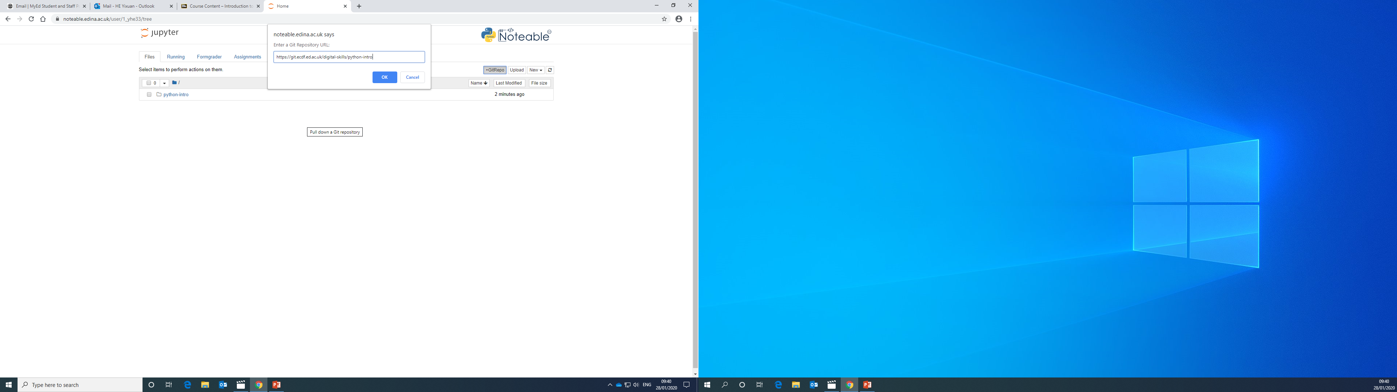
2. Clone GitRepo(recommended)

Slide 16
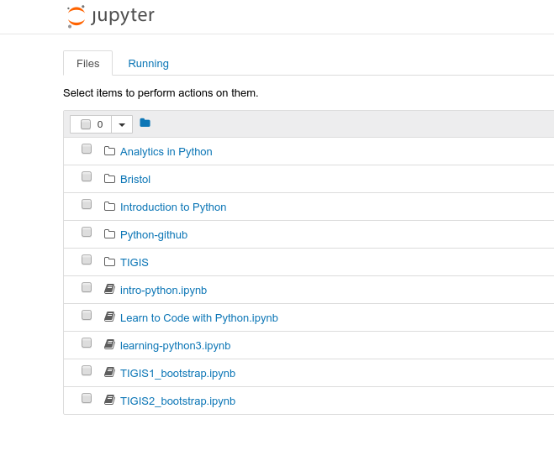
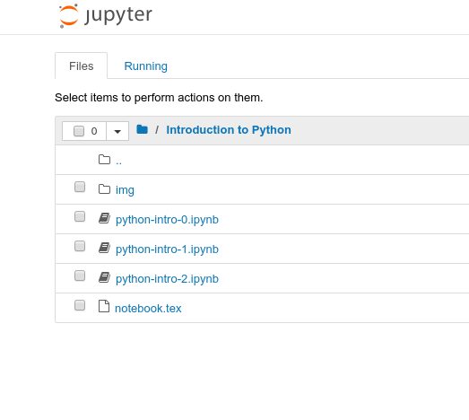
3. Starting a notebook
Notes:
Start a notebook by clicking on it.
Notebook 0 is an environment introduction.
Skip that, open notebook 1
Make sure that everybody is ready

Slide 17
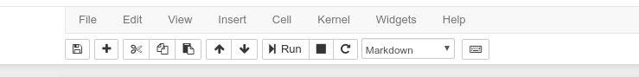
4. Toolbar
Stop execution
Save
Cut, copy
paste
Block type
New block
Move block
Reset block
And clear output
Notes:
Autosave

Slide 18
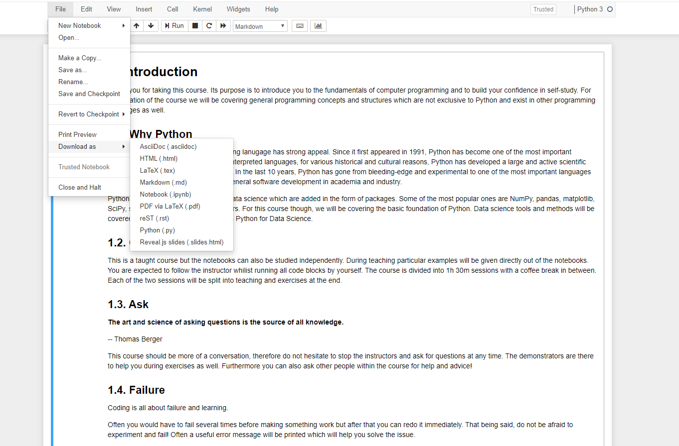
5. Download files

Slide 19
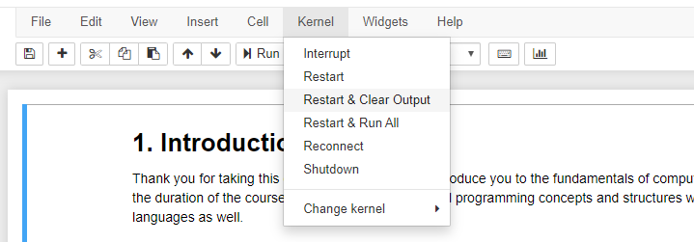
6. Kernel/Restart & Clear output

Slide 20
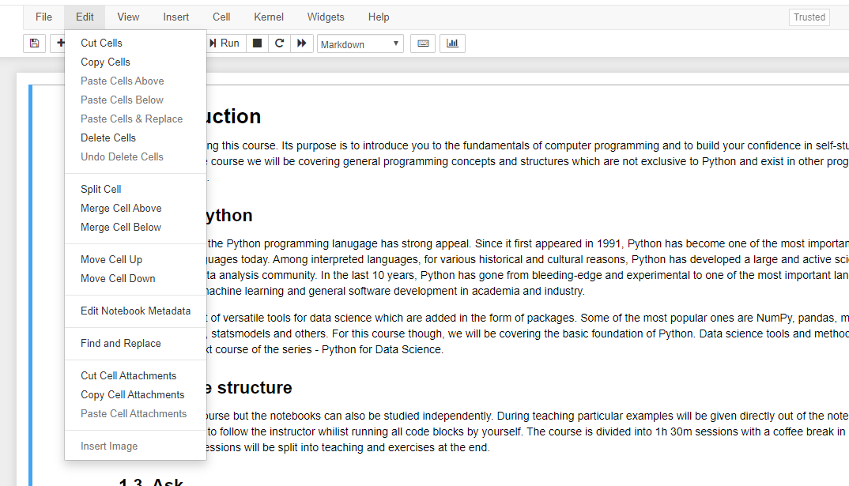
7. Edit/Delete Cell

Slide 21
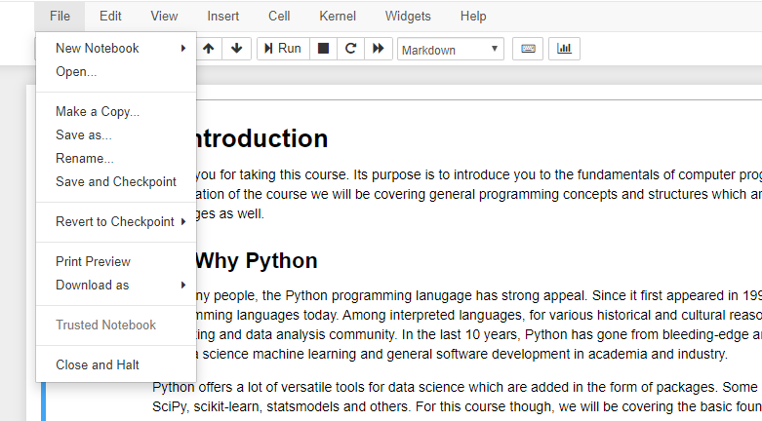
8. File/ Close & Halt

Slide 22
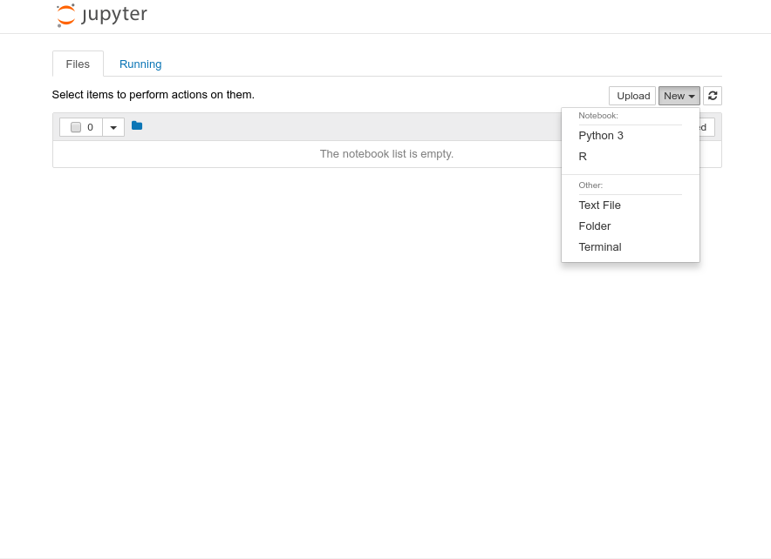
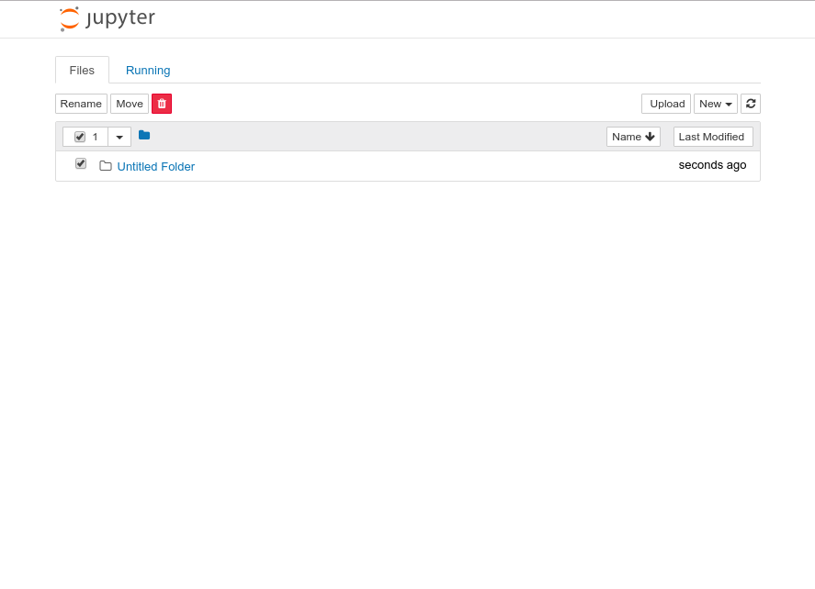
9. Create a folder 10.Rename
Notes:
We need to make a course folder
Then rename it to Introduction to Python or whatever
Then go into that folder

Slide 23
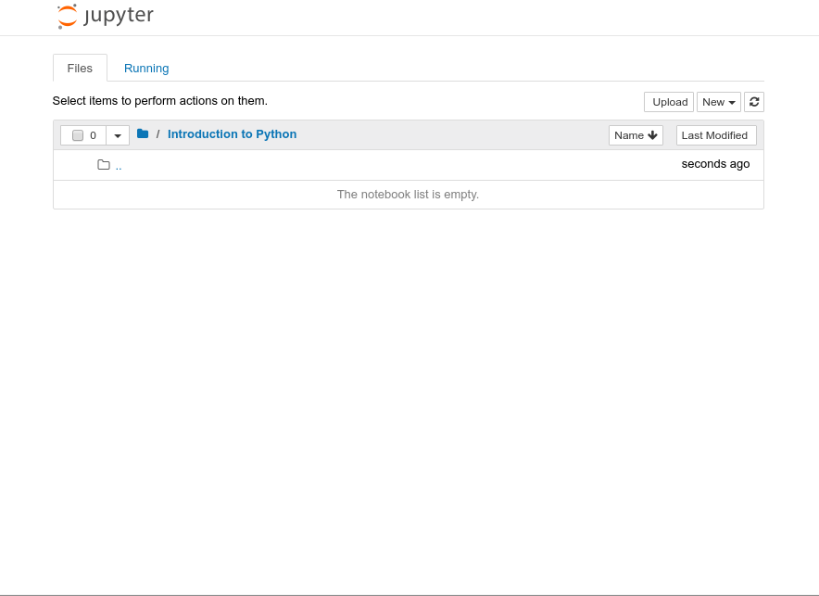
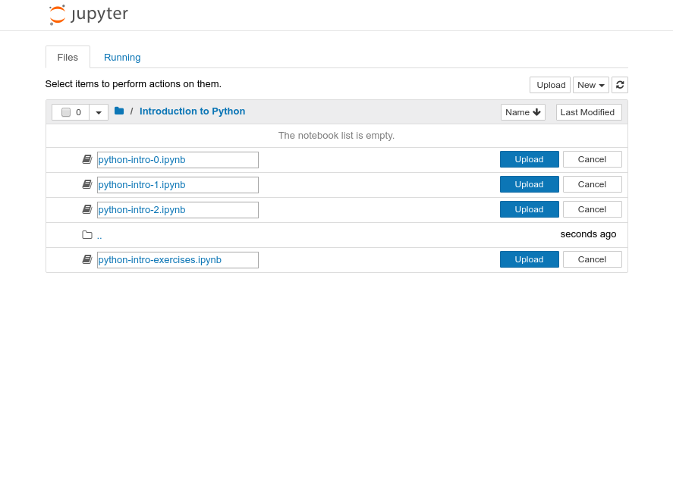
11. Upload files
Notes:
Make sure that you are inside that folder

Slide 24
Running blocks
By pressing the Run button
Shift + Enter – runs block
Alt + Enter – creates a new block
Notes:
Run button but its best with shortcut Shift + Return/Enter
Alt + Return/Enter which creates a new block after the on you are currently on.

Slide 25
Other operations
File/Save and Checkpoint
File/Revert to Checkpoint
Tab completion
Introspection
Notes:
Checkpoints are useful!
You can download it as multiple different things:
Notebook
Python script
pdf

Slide 26
Let us start
If you like to follow along, you can open your own notebook. But please try to keep up with my presentation, as you still have time for exercises after the teaching.

Slide 27
Agenda
Variables
Types
Arithmetic operators
Boolean logic
Strings
Printing
Exercises

Slide 28
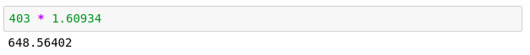
Python as a calculator
Let us calculate the distance between Edinburgh and London in km
Notes:
Let's run our first block.
That's great
Writing numbers is very tedious
Run this in your notebooks
How can we improve that?

Slide 29
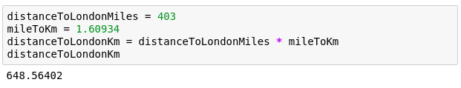
Variables
Great calculator but how can we make it store values?
Do this by defining variables
Can later be called by the variable name
Variable names are case sensitive and unique
Notes:
Can we save values? By defining a variable.
Can have values assigned
Variables must be declared and can then be called by name.
Code example
Check the code yourself

Slide 30
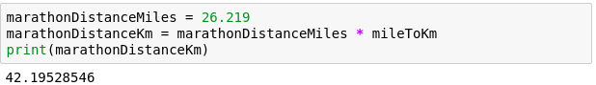
We can now reuse the variable mileToKm in the next block without having to define it again!
Notes:
reuse without having to type in again
Note: mileToKm not defined again

Slide 31
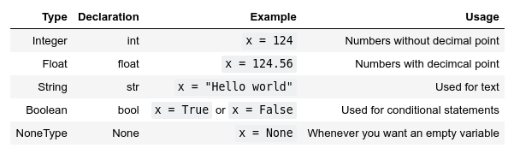
Types
Variables actually have a type, which defines the way it is stored.
The basic types are:
Notes:
So far - storing values in memory; how exactly are they stored?
defined by the type.
Go over all types

Slide 32
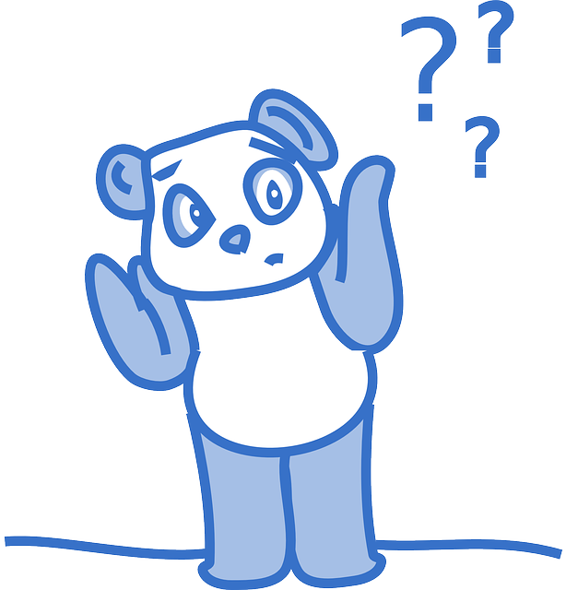
Why should we care?
Image by Clker-Free-Vector-Images on Pixabay
Notes:
Python decides the types, why should we care?
Python uses duck typing
Try running the next block

Slide 33
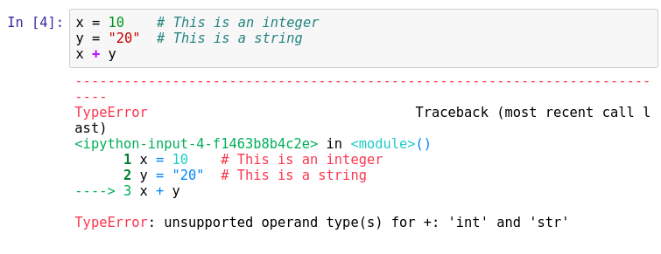
Important lesson to remember!
We can't do arithmetic operations on variables of different types. Therefore make sure that you are always aware of your variables types!
You can find the type of a variable using type(). For example type type(x).
Notes:
Explain code, run it.
we broke python. Any ideas?
Don't be afraid of errors, they are invaluable
we can't add up variables of different types.
important to remember! always take note of what the types of your variables are!
Python is helpful and gives us a hint.
Can you fix this particular block?

Slide 34
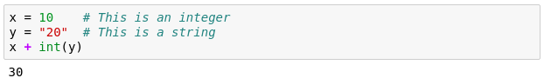
Casting types
Luckily Python offers us a way of converting variables to different types!
Casting – the operation of converting a variable to a different type
Similar methods exist for other data types: int(), float(), str()
Notes:
Casting – the operation of converting a variable to a different type
Let's try it on the previous code snippet.
Take note that this works only in a sensible way!

Slide 35
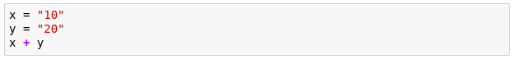
Quick quiz
What will be the result?

Slide 36
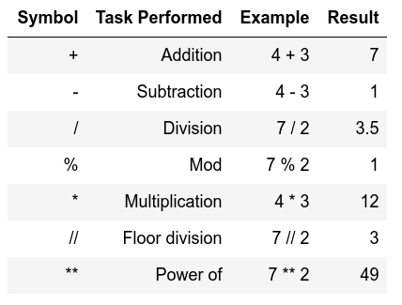
Arithmetic operations
Similar to actual Mathematics.
Order of precedence is the same as in Mathematics.
We can also use parenthesis ()
Notes:
Note of order precedence.
Table doesn't show this
Should be intuitive for all of you.

Slide 37
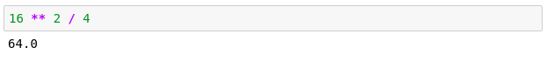
Order precedence example

Slide 38
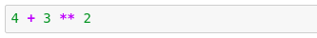
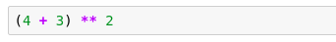
Quick quiz
vs
13
49

Slide 39
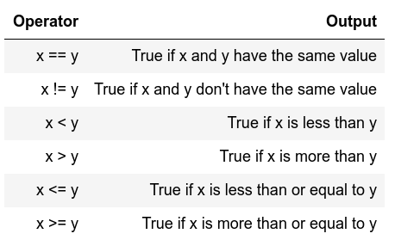
Comparison operators
I.e. comparison operators
Return Boolean values
(i.e. True or False)
Used extensively for conditional statements
Notes:
Similar to mathematics again
Will become important later on.

Slide 40
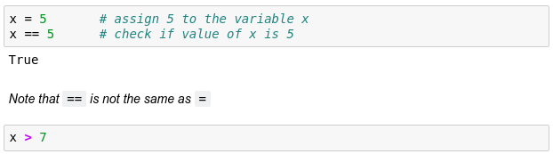
Comparison examples
False
Notes:
Note variable passing down
What will the 2nd block return?

Slide 41
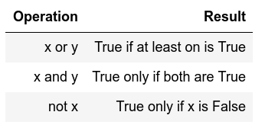
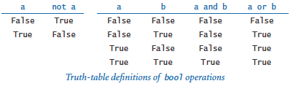
Logical operators
Allows us to extend the conditional logic
Will become essential later on
Notes:
how we can combine comparison operators and logical operators

Slide 42
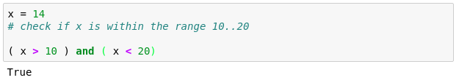
Combining both
True
True

Slide 43
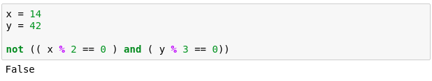
Another example
True
True
True
That wasn't very easy to read was it?
Is there a way we can make it more readable?
Notes:
Another more complex example.
Here we check if x is divisible by 2 and if y is divisible by 3.
Can anybody guess why we are getting False?

Slide 44
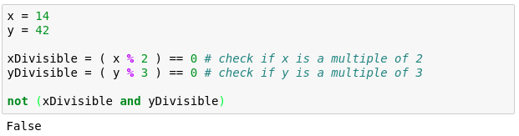
Notes:
Simpler – store intermediate values
Easier to read
Generally advised

Slide 45
Strings
Powerful and flexible in Python
Can be added
Can be multiplied
Can be multiple lines

Slide 46
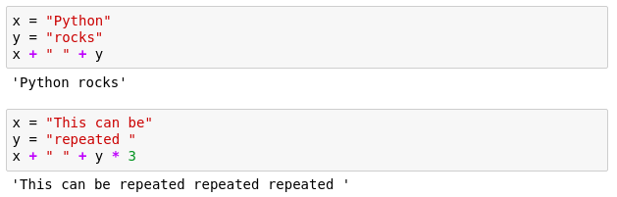
Strings

Slide 47
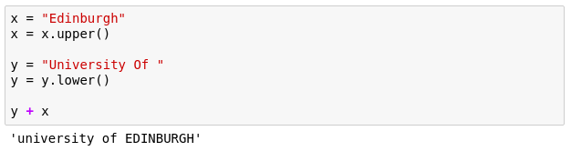
Strings
These are called methods and add extra functionality to the String.
If you want to see more methods that can be applied to a string simply type in dir('str')
Notes:
Functionality of strings can be extended through methods
should be in your notebooks but the dir() can be used on any Object/variable

Slide 48
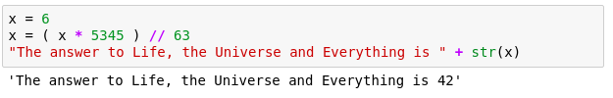
Mixing up strings and numbers
Often we would need to mix up numbers and strings.
It is best to keep numbers as numbers (i.e. int or float)
and cast them to strings whenever we need them as a string.
Notes:
We need to mix numbers and strings often, ie. Whenever printing.
best to keep numbers as numbers
cast them to strings whenever needed.

Slide 49
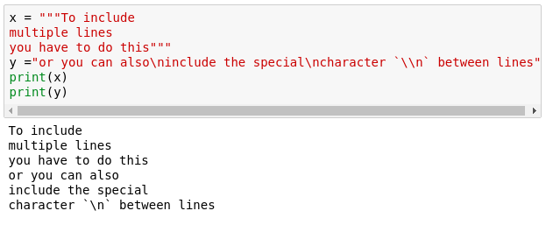
Multiline strings
Notes:
Sometimes we need strings on multiple lines. How? Two ways?
One is using triple quotes """
The other one is using the new line character - \n

Slide 50
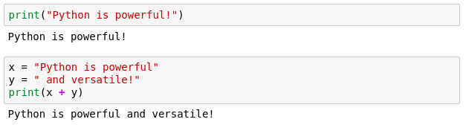
Printing
When writing scripts, your outcomes aren't printed on the terminal.
Thus, you must print them yourself with the print() function.
Beware to not mix up the different type of variables!

Slide 51
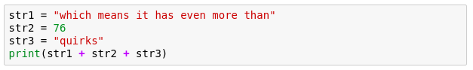
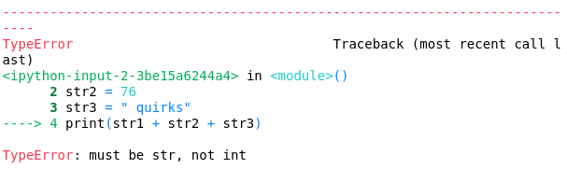
Quick quiz
Do you see anything wrong with this block?
Notes:
Let's see if everybody remembers their types
Is there anything wrong with this block or will it execute nicely?
[issue] Any idea how we can fix it?

Slide 52
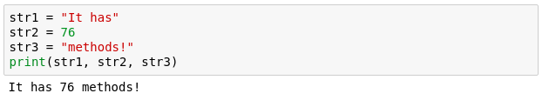
Another more generic way to fix it
If we comma separate statements in a print function we can have different variables printing!

Slide 53
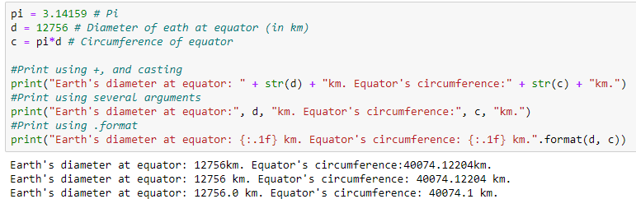
Placeholders
A way to interleave numbers is
Elegant and easy
more in your notes
Notes:
More examples including Exp, Octal, Hex, Etc in your notebooks

Slide 54
Commenting
Useful when your code needs further explanation. Either for your future self and anybody else.
Useful when you want to remove the code from execution but not permanently
Comments in Python are done with #
Notes:
You seen the # symbols in the slides.
I forget what I write; need to remind my future self
Programmers though it's better to write explanation in between the code
Show example

Slide 55

Exercise time
Simple and fun exercises.(notebooks 0 and 1)
20-minute break afterwards.
Failure is progress!
Ask us anything. Ask among yourselves as well.
Notes:
error checking code , don't change it

